Slide 1

Tutorial at ATRDS 2025 on Customizing LLMs for ATM: Challenges and Opportunities
Thinh PHAM and Yash Guleria
June 2025

Slide 2


Outline
LLMS AND ITS APPLICATIONS
HAND-ON EXERCISE ON SCENARIO GENERATION

Slide 3
LLMS AND ITS APPLICATIONS

Slide 4
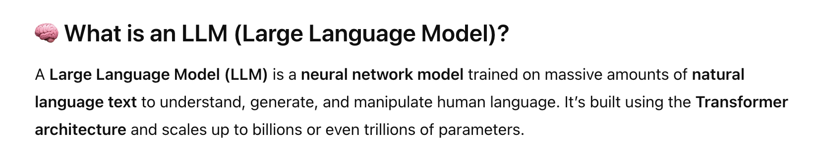
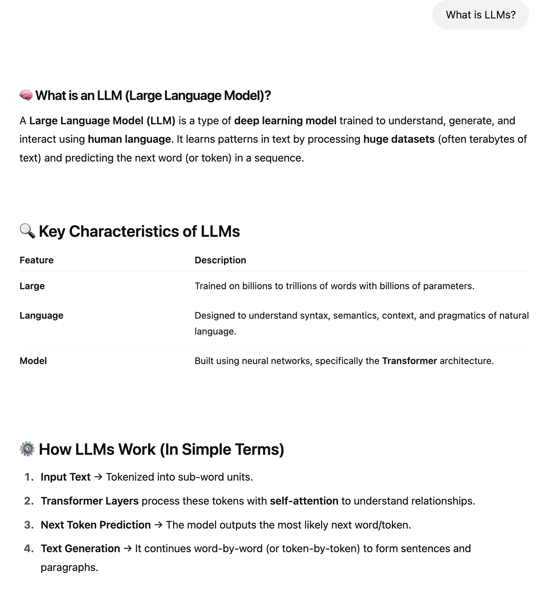
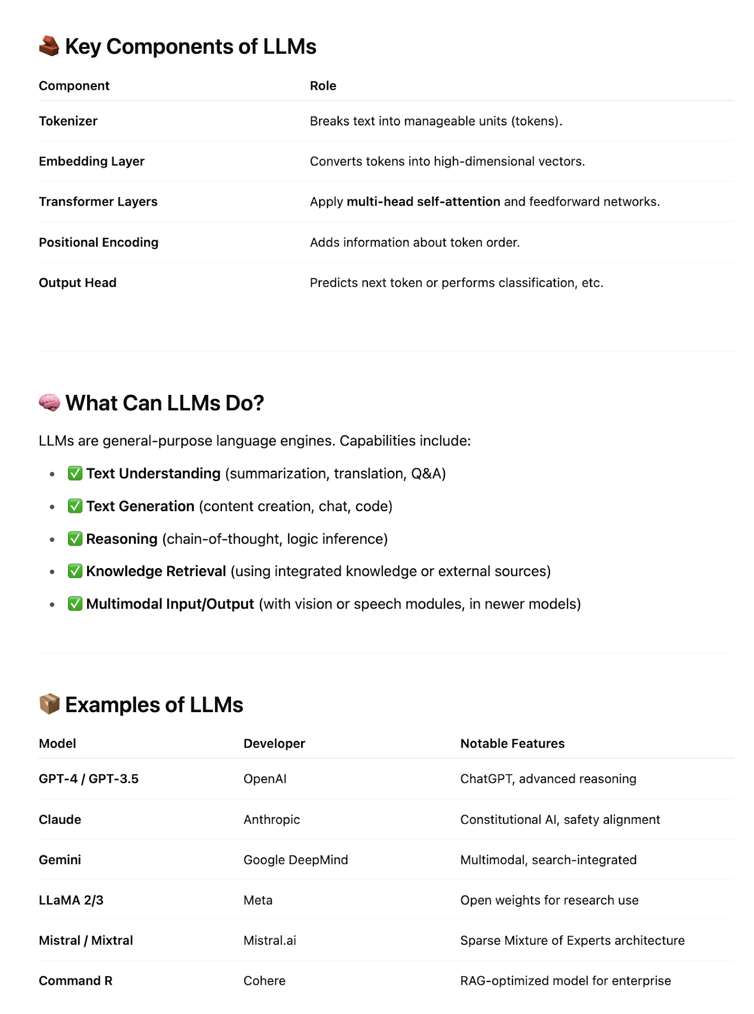

Slide 5
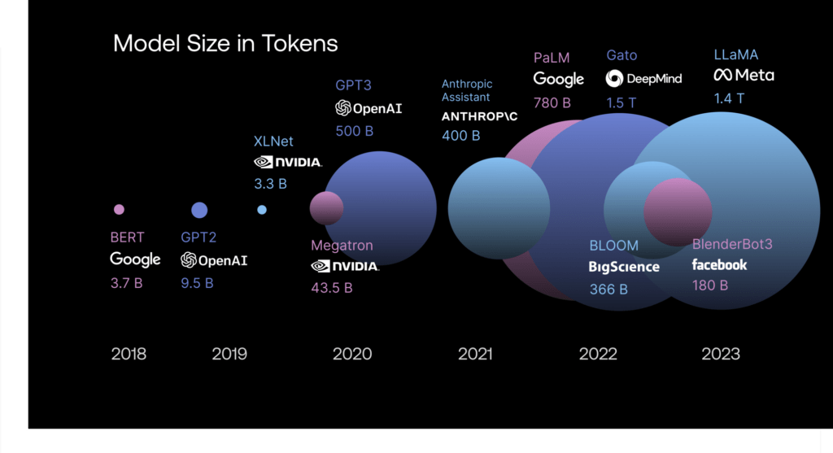
LLM model size: Comparing top models
(Source: Scale.com/guides/large-language-models)

Slide 6
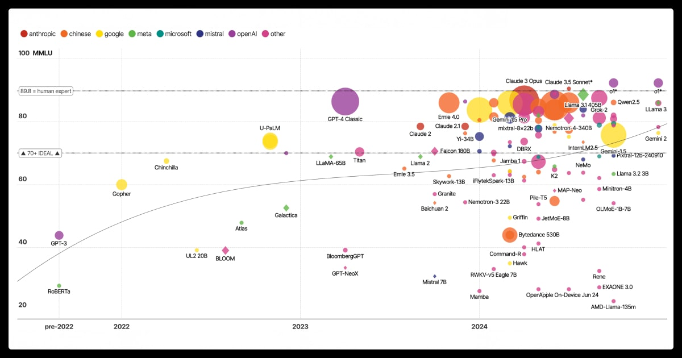
LLM model size: Comparing top models
LLM performance and timeline comparison
(Source: information is beautiful)

Slide 7
General Challenges of LLMs
Category | Challenge | Description
Accuracy | Hallucination | LLMs may invent facts, especially when unsure or poorly grounded.
Explainability | Opaque Decisions | Difficult to trace how conclusions are formed, limiting trust in safety-critical domains.
Robustness | Fragility to Inputs | Small changes in phrasing can lead to wildly different outputs.
Bias & Fairness | Data Imbalance | Models can inherit or amplify biases in training data.
Security | Prompt Injection | Malicious inputs can alter LLM behavior or extract sensitive info.
Data Privacy | Sensitive Leakage | Risk of memorizing or leaking private data from fine-tuning sets.
Resource Use | Compute & Cost | Training/serving LLMs demands high computational resources.
Evaluation | No Clear Metrics | Hard to objectively measure output quality, especially in open-ended tasks.

Slide 8
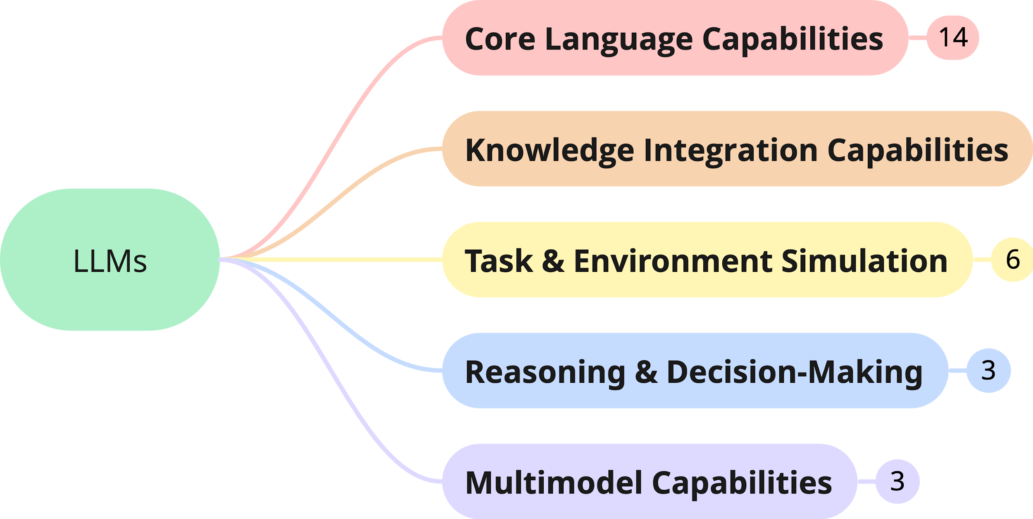
LLM Core Capabilities
Application Class
Applications

Slide 9
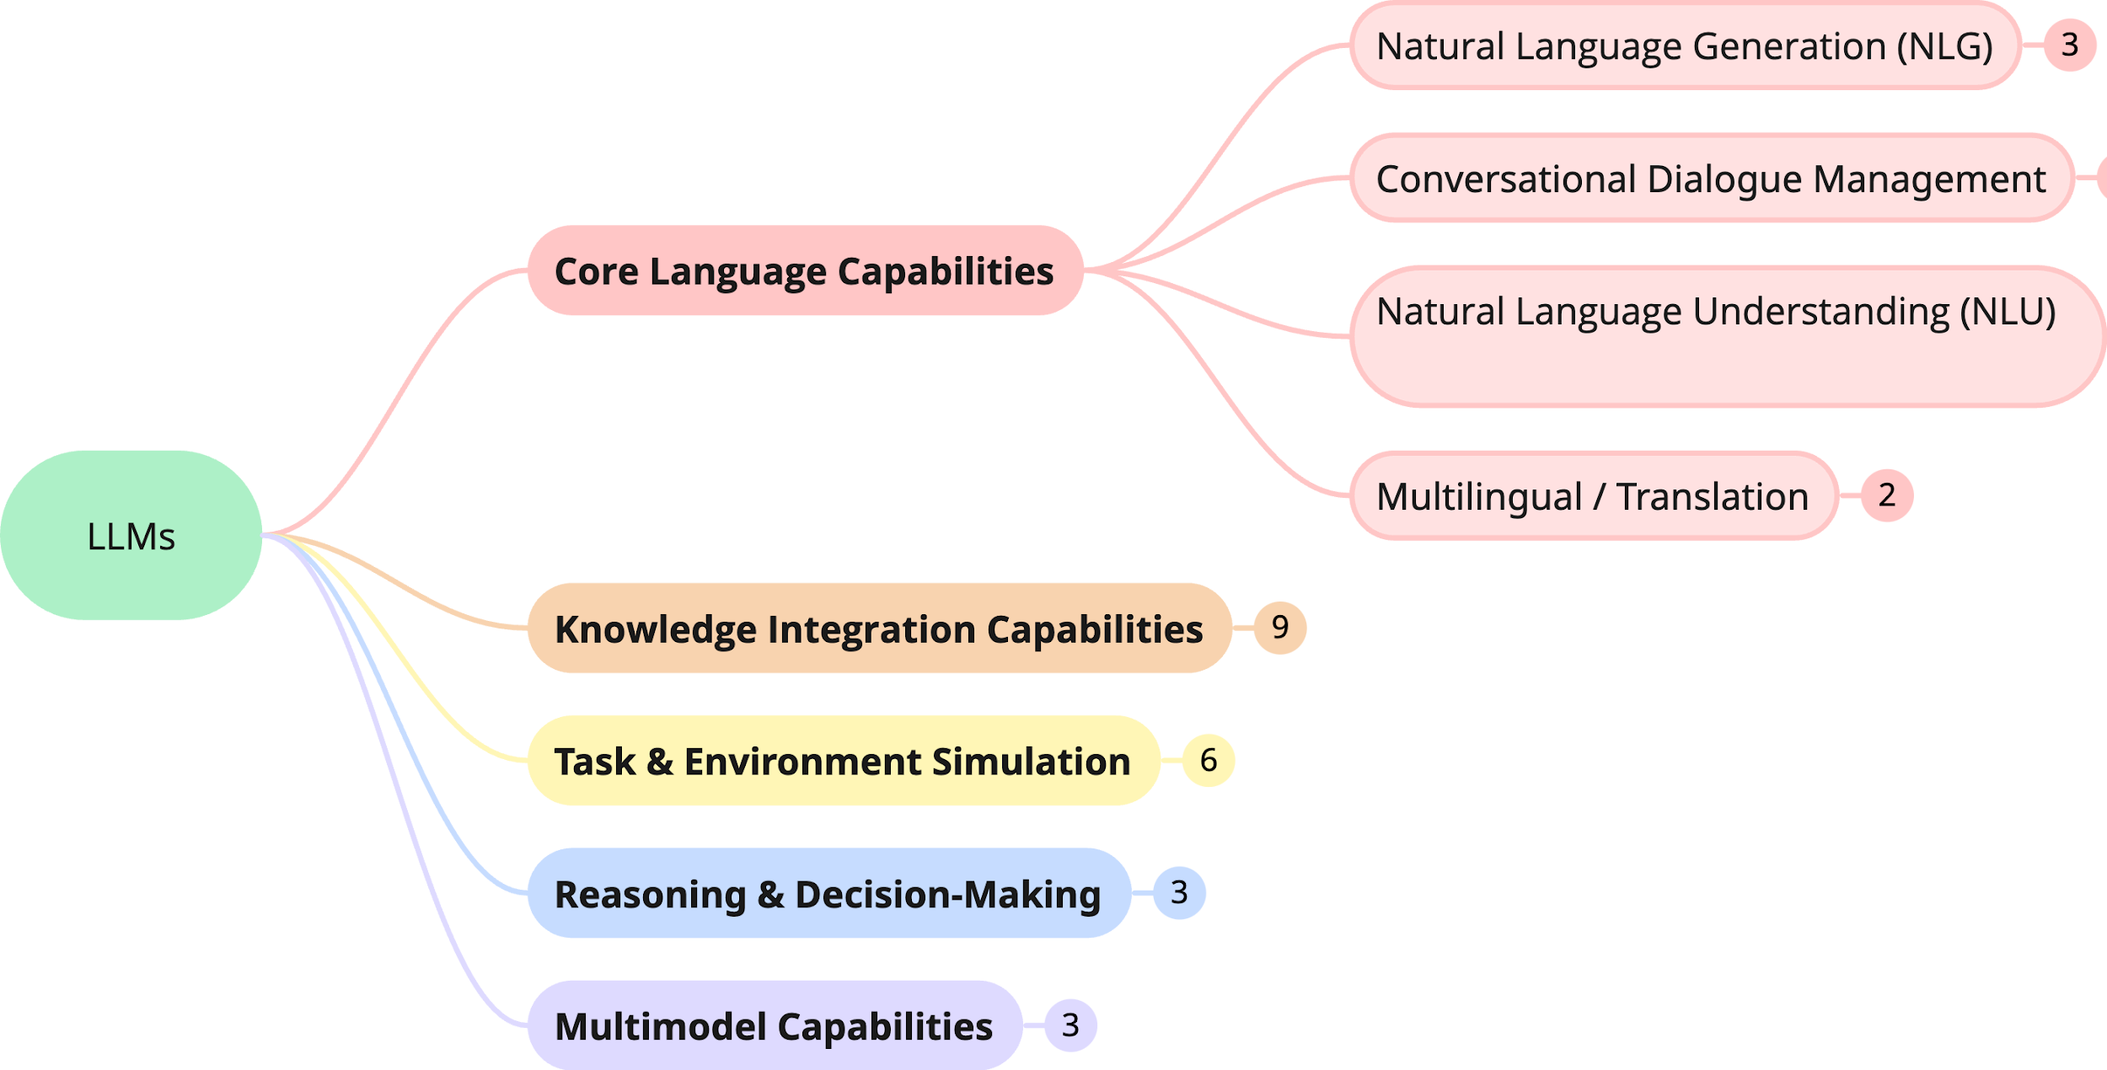
LLM Core Capabilities
Application Class
Applications

Slide 10
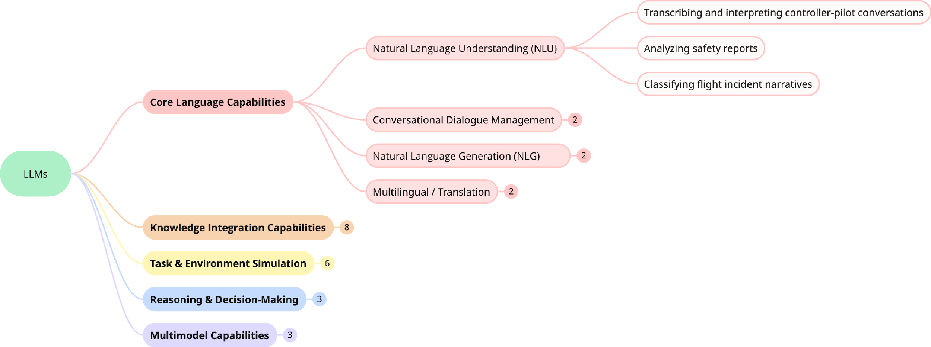
LLM Core Capabilities
Application Class
Applications

Slide 11
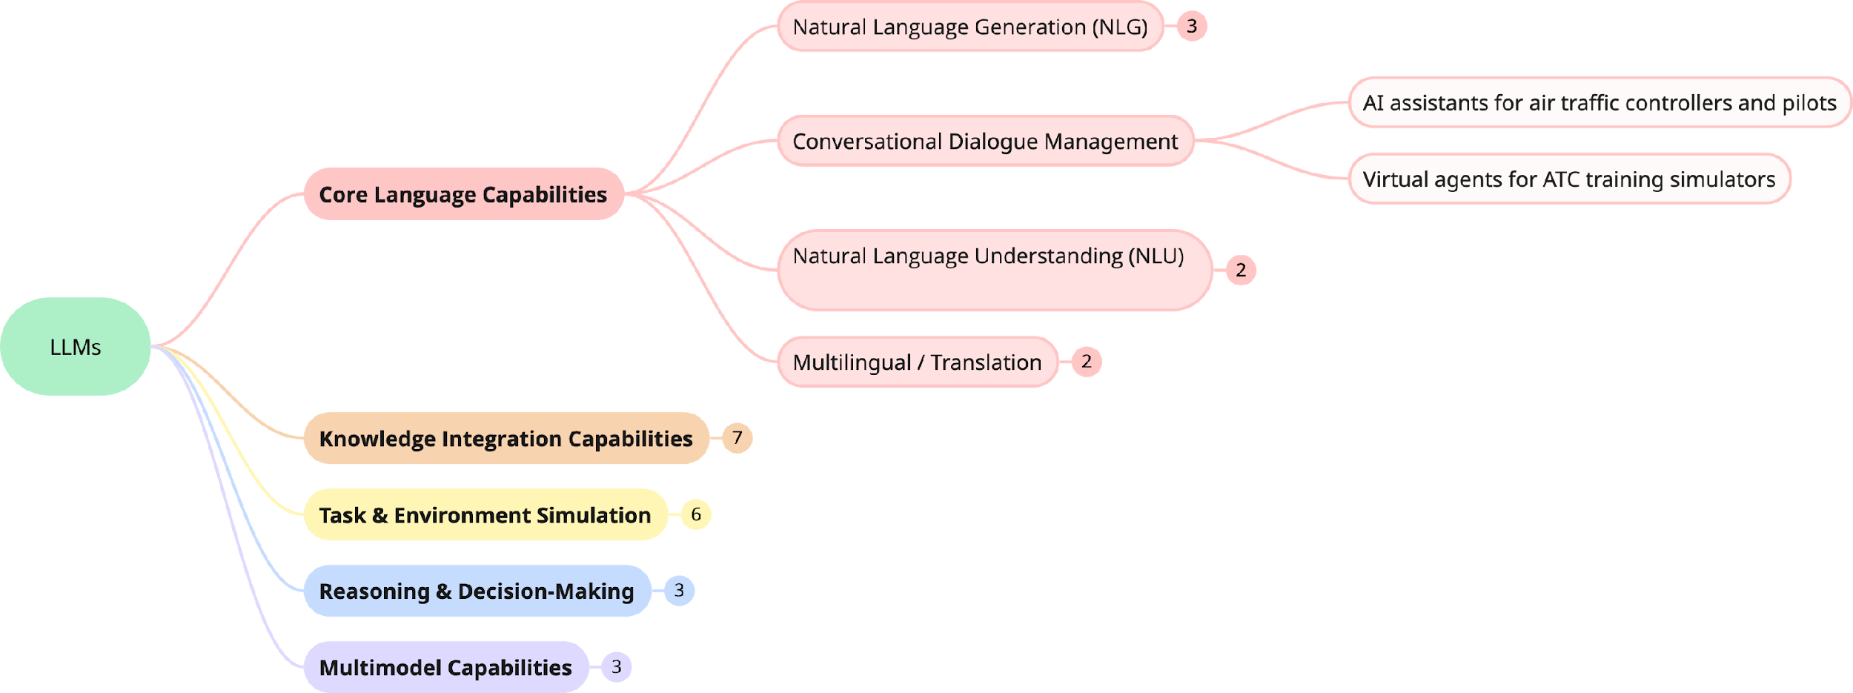
LLM Core Capabilities
Application Class
Applications

Slide 12
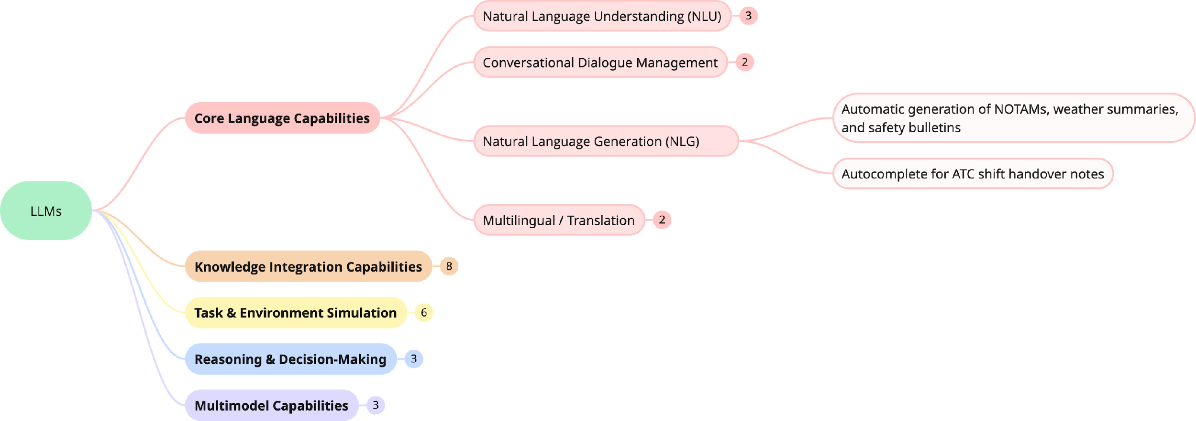
LLM Core Capabilities
Application Class
Applications

Slide 13
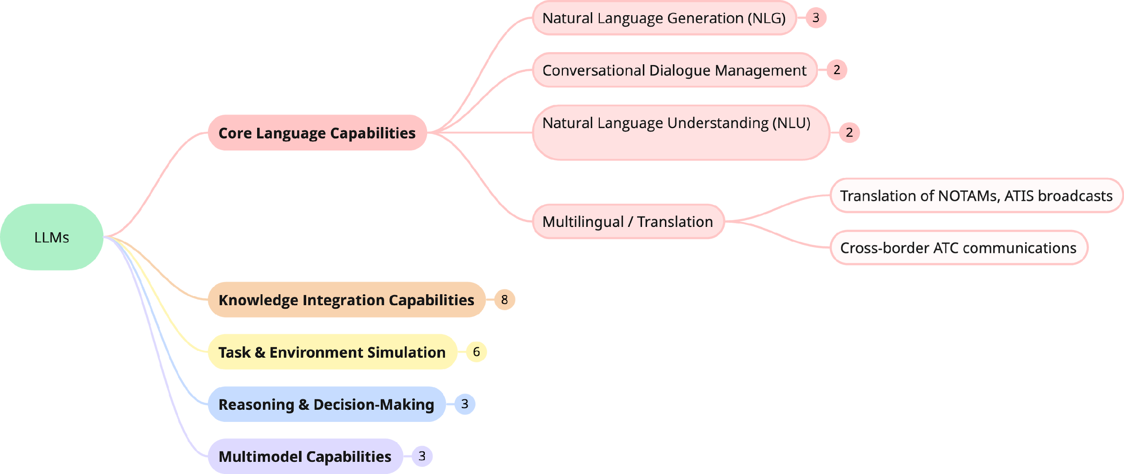
LLM Core Capabilities
Application Class
Applications

Slide 14
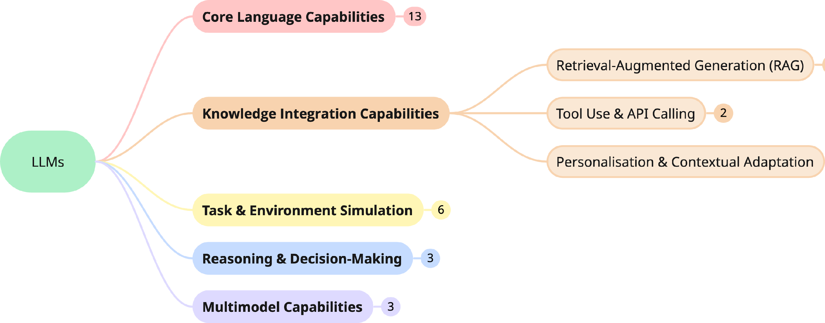
LLM Core Capabilities
Application Class
Applications

Slide 15
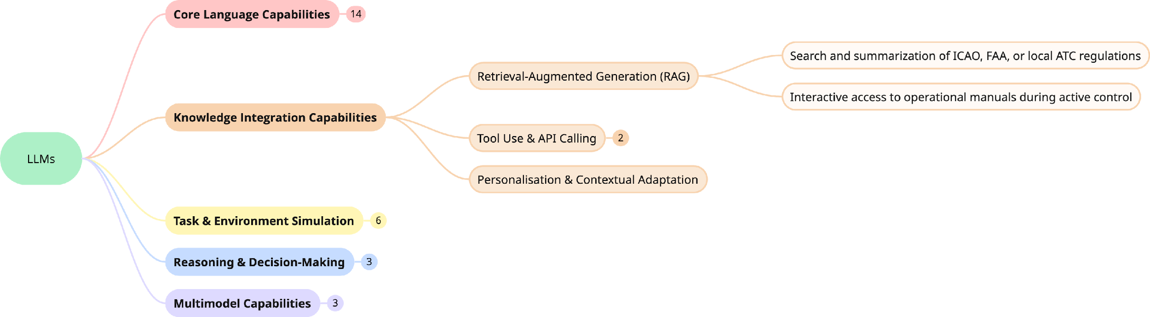
LLM Core Capabilities
Application Class
Applications

Slide 16
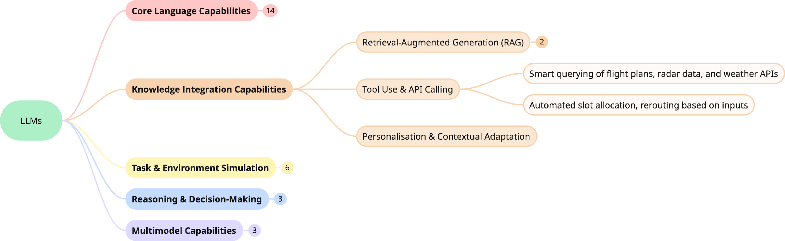
LLM Core Capabilities
Application Class
Applications

Slide 17
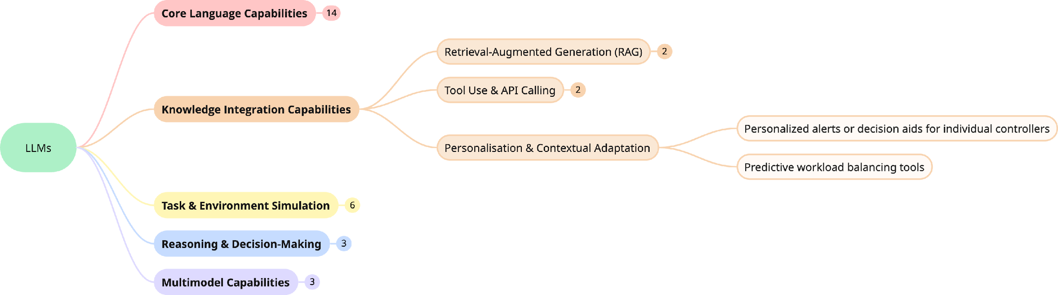
LLM Core Capabilities
Application Class
Applications

Slide 18
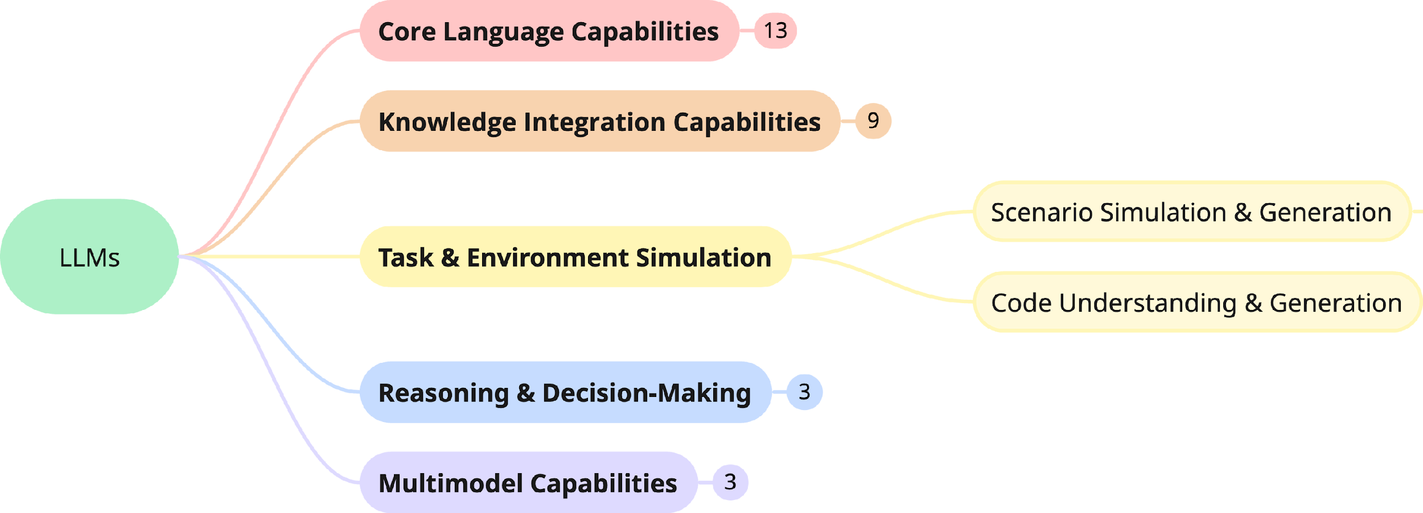
LLM Core Capabilities
Application Class
Applications

Slide 19
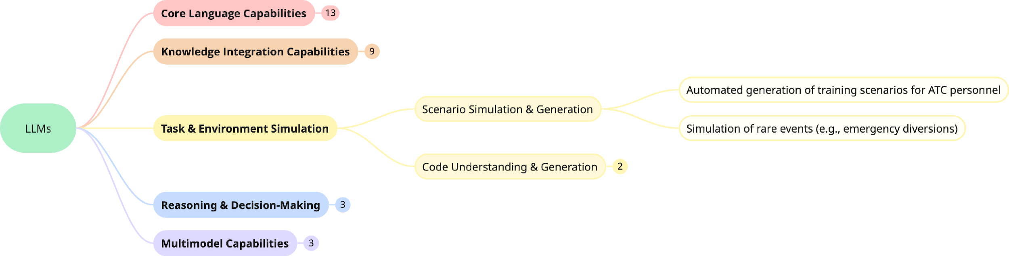
LLM Core Capabilities
Application Class
Applications

Slide 20
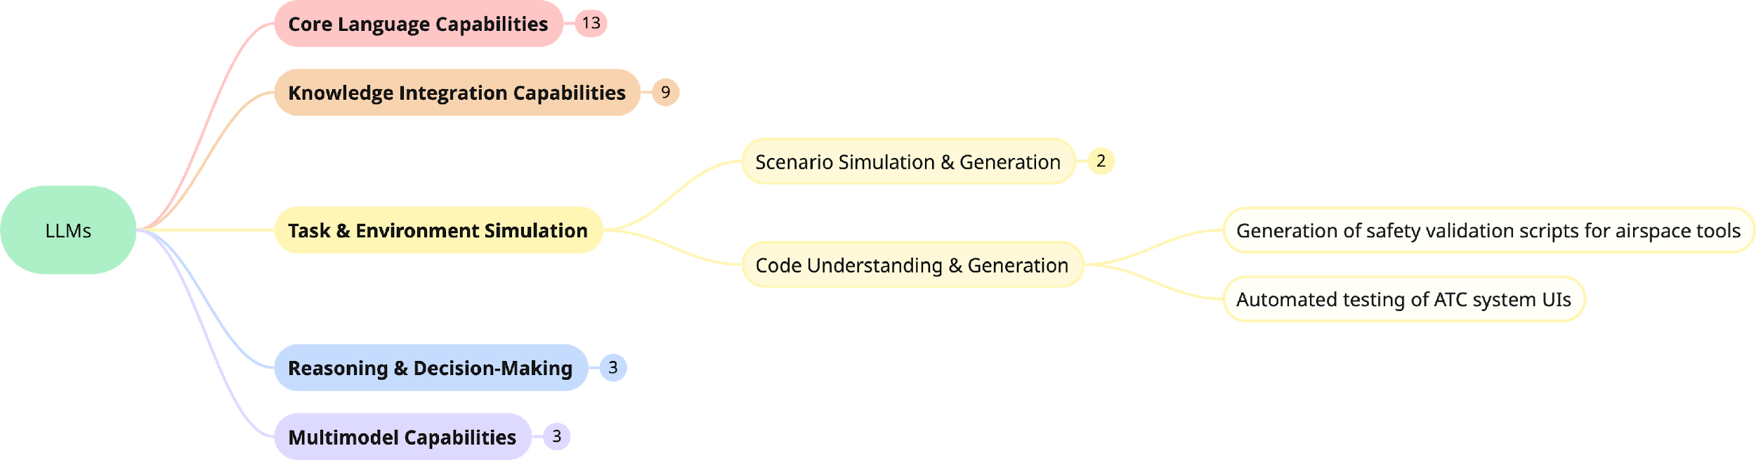
LLM Core Capabilities
Application Class
Applications

Slide 21
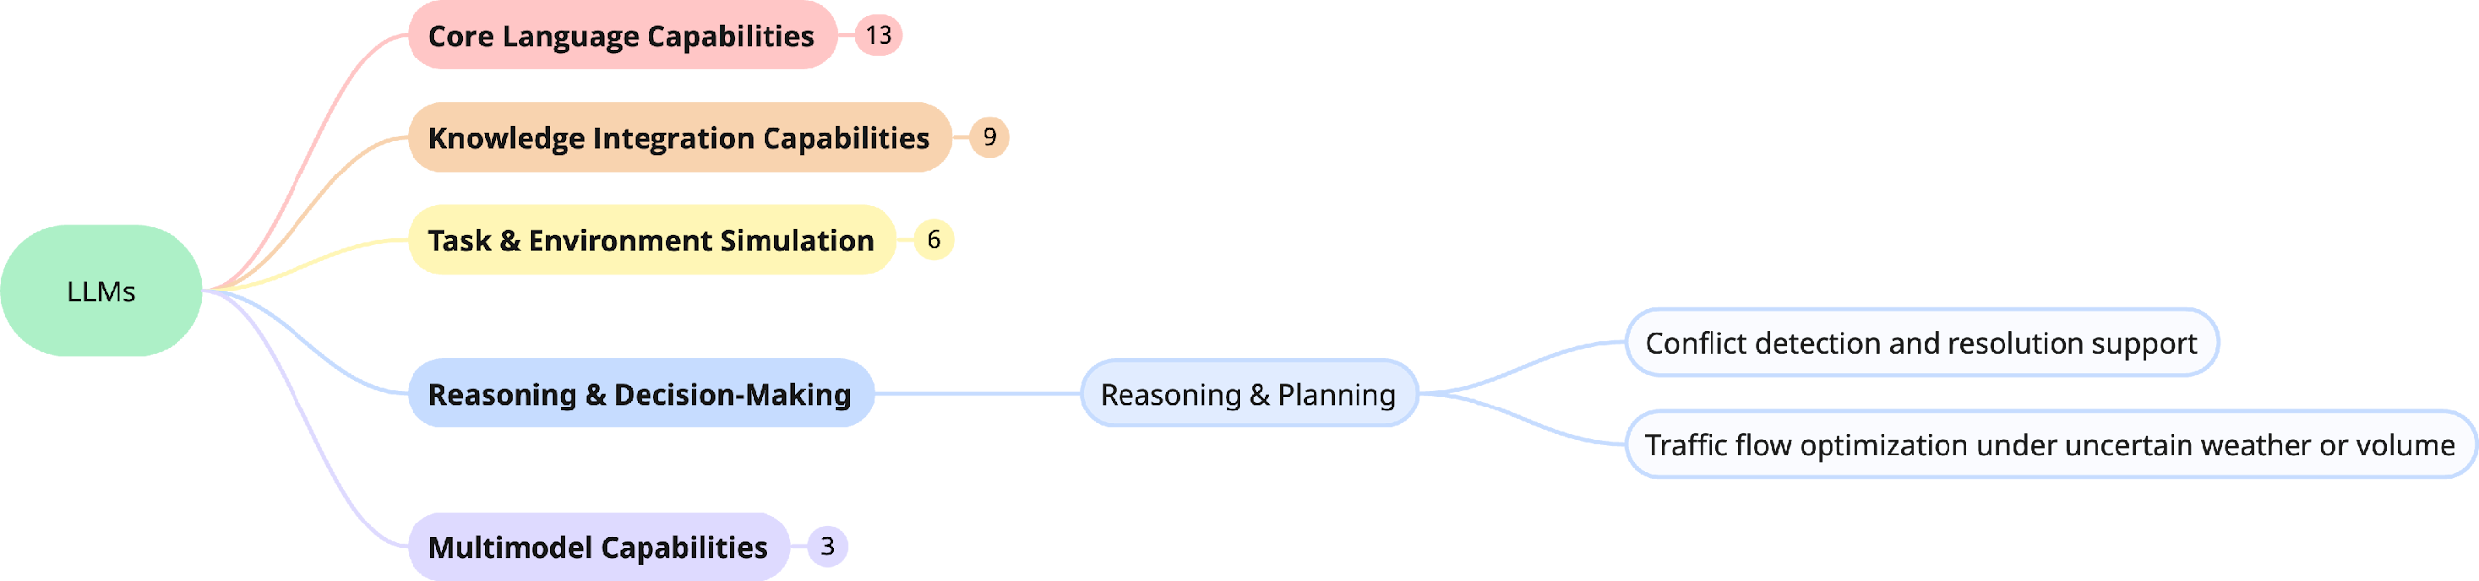
LLM Core Capabilities
Application Class
Applications

Slide 22
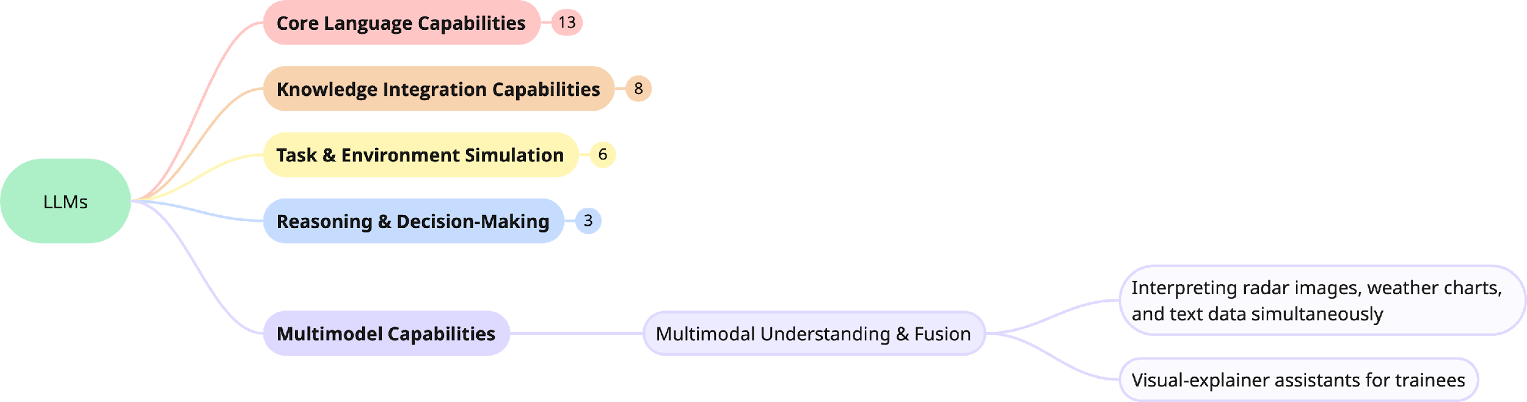
LLM Core Capabilities
Application Class
Applications

Slide 23
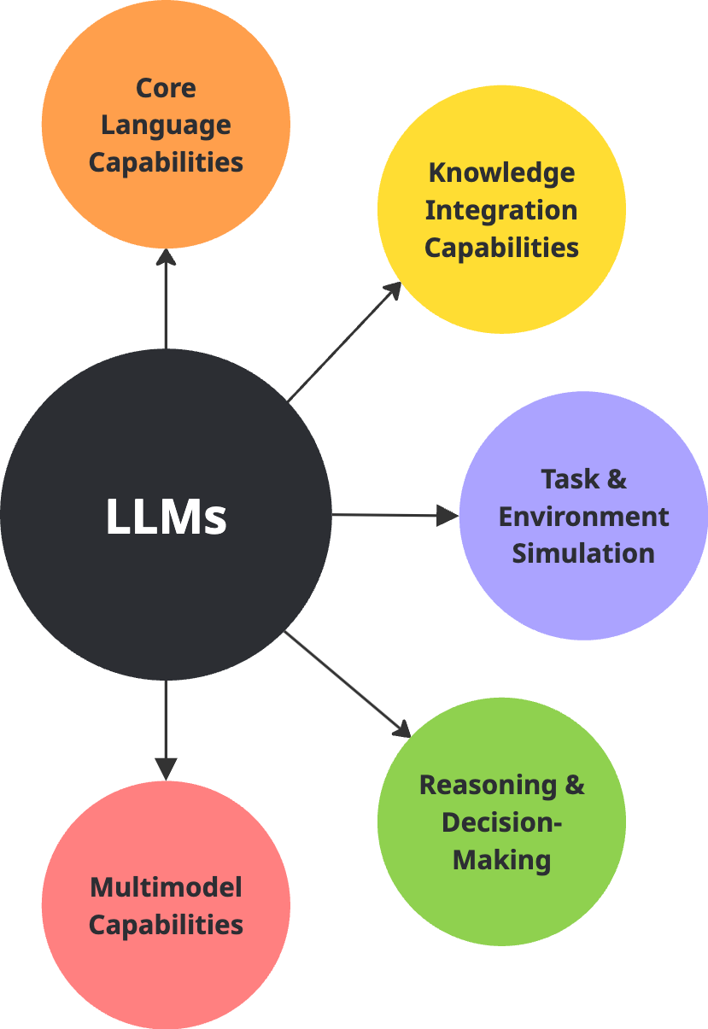
Mitigating LLMs Challenges
Capability | Key Challenge(s) | Recommended Mitigation(s)
Text Understanding | Ambiguity, shallow context | Domain tuning, longer context, structured prompts
Information Extraction | Inconsistency, hallucination | Structured outputs, weak supervision, regex post-process
Knowledge Reasoning | Hallucination, gaps in inference | RAG, fact-checking, self-consistency
Information Retrieval | Query mismatch, poor ranking | Dense retrievers, LLM reranking, query reformulation
Chat & Dialogue | Repetition, contradiction | Dialogue state tracking, memory summarization
Content Generation | Hallucination, lack of control | RLHF, prompt tuning, safety filters
Code Generation | Syntax errors, outdated code | Updated code corpora, testing, prompt chaining
Reasoning & Planning | Shallow logic, lack of planning | CoT, ReAct, symbolic hybrids
Simulation & Forecasting | Poor realism, uncertainty | Hybrid simulation, probabilistic modeling
Multi-modal Understanding | Misalignment, modality fusion | Cross-modal attention, aligned datasets
Tool Use & Agent Planning | API misuse, failed planning | ReAct, action logging, tool-aware fine-tuning

Slide 24
HAND-ON EXERCISE ON SCENARIO GENERATION

Slide 25
Discussion Points
Motivation and challenges
LLM Framework in the exercise
Hands-on Tutorial:
Setup instructions.
LLMs Model Selection
Retrieval Augmented Generation (RAG) Preparation
Prompt Design
Structured Output
Post-processing for Verification and Validation
Discussion and Key Takeaways

Slide 26
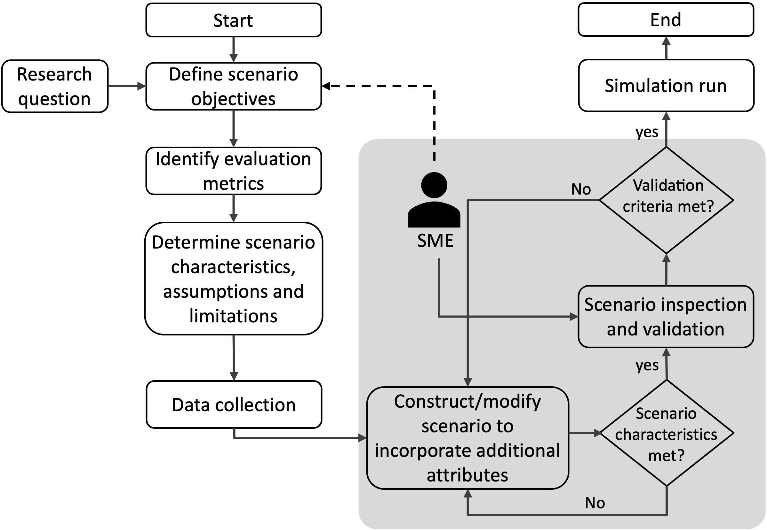
SCENARIO GENERATION
1
Motivation
Air traffic scenarios are critical enablers for:
Algorithm development and testing
Operational concept evaluation
Human factors research
Current challenges in scenario generation:
Development bottlenecks
Scale vs fidelity constraints
Multi-source data integration
Figure 1. An illustration of a typical scenario generation process involving a scenario developer and a Subject matter expert (SME), highlighting the iterative process involved in scenario generation.
Air traffic scenarios generation is a critical but a challenging aspect of ATM research and development.

Slide 27


LITERATURE
2
LLMs and their Applicability
Air Traffic Management Use case (Text-To-Text):
Challenges when considering LLMs:
Q&A, Summarization tasks – AviationGPT (2024)
Ground delay program (GDP) information management (summarization) – ChatATC (2024)
Aviation safety Analysis and incident reporting system (report analysis) - ASRS (2023)
LLMs are fundamentally designed for unstructured output.
Scenario generation involves generating structured outputs, which is difficult for language model (at-least small scale).
Fine-tuning is not feasible due to scale/ unavailability of data.

Slide 28
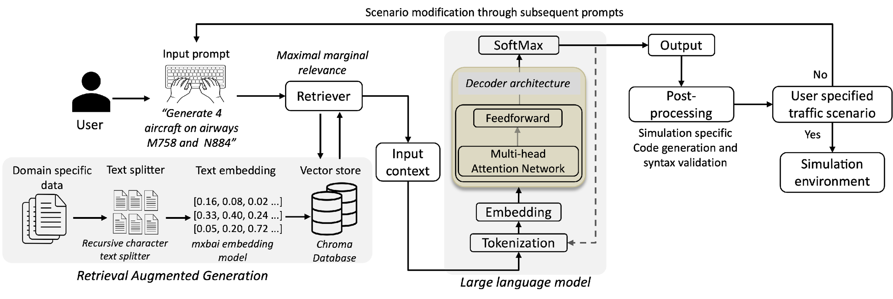
OVERALL METHODOLOGY
3
Components
Language model – Cohere’s Command R
Retrieval module
Post-processing module
Module 1
Module 3
Module 2
Figure 3: The proposed methodology employs Retrieval-Augmented Generation (RAG) to extract sector specific information—airways, waypoints, and aircraft types from domain-specific documents, facilitating tailored air traffic scenarios generation.

Slide 29
GitHub link and setup Instructions
https://github.com/yashGuleria/ATRDS_LLM_Tutorial

Slide 30
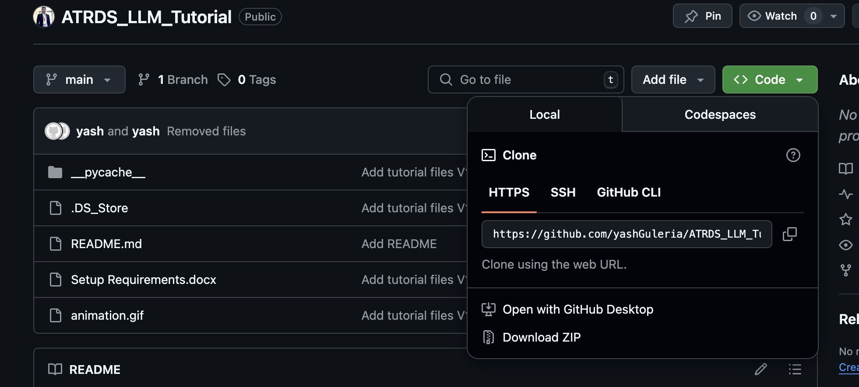

Slide 31
steps
Extract the contents of the zipped folder.
View the Setup Requirements document:
Required:
A google account.
Cohere account (to access the API).
Open google drive.
Select ‘MyDrive’ and upload the folder.
Open ‘tutorial.ipynb’.

